Slide 1
Advanced Analytical Chemistry 1
Separation Technique, Chromatography
For Postgraduate (Master's degrees)
Lecture No. 3
By
Asst. Prof. Dr. Layla Salih Al-Omran

Slide 2
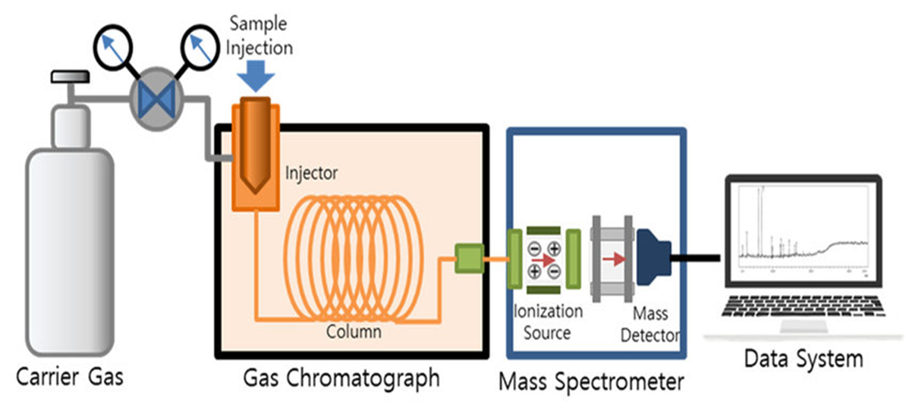
6. Amplification & Recorder system ( Data System)
Recorders are used to record the response obtained from the detectors after amplification.
These use special electronic circuits to display in an understandable graphical format that represents several peaks of the constituents of the sample under analysis.
These peaks are called a chromatogram.

Slide 3
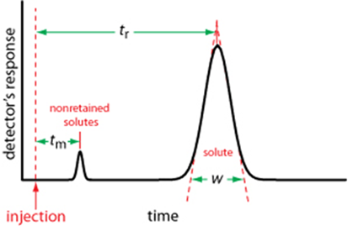
Chromatogram
It is a plot of detector`s signal as a function of time or volume of eluted mobile face. It consists of a peak for each of the separated solute bans.
Volume or time it takes for an analyte to come out from the column is known as retention volume or retention time t_{r}
w, which, we measure by extending tangent lines from the inflection points on either side of the chromatographic peak through the baseline
Peak area is proportional to the amount of single analysed sample.

Slide 4
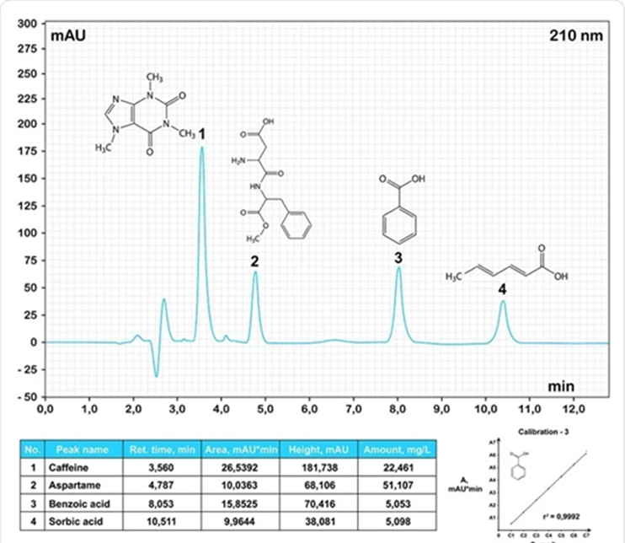
Example: Chromatogram of mixture of organic compounds.

Slide 5
Sample Preparation and applications of Gas Chromatography
Sample Preparation
The sample that is injected into the gas chromatograph following sample preparation must be either a liquid or a gas.
The analytes must be volatile enough under the conditions of the inlet and column and
The matrix interferences must also be volatile, so as not to contaminate the instrument or column.
Depending on the physical state (solid, liquid and gas), different methodologies are followed.

Slide 6
Sample Preparation
(1) To treat solid samples and separate a target analyte, some enhanced solvent extraction methods, such as liquid extraction, microwave and ultrasonic extraction
(2) In a liquid sample, the analyte trapping methods such as solid-phase extraction, solid-phase microextraction, membrane extraction and single-drop microextraction (SDME) are used.
(3) For analytes in the gas phase, trapping analytes from vapor samples and headspace analysis are used.
As a result, possesses different ways to treat and convert matrix into a suitable sample to inject GC is very important.
In general, prior to the GC analysis the common 3 steps should be followed.
Extraction, Concentration, and Clean-up

Slide 7
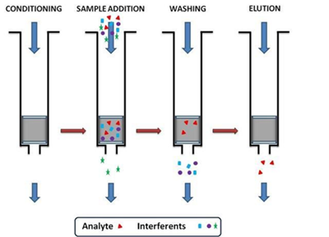
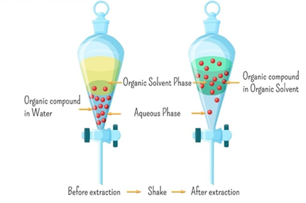
Extraction:
The extraction procedure isolates the contaminants from the matrix.
Two major kinds of extraction include solid-phase extraction (SPE) and liquid-liquid extraction (LLE).
The solvents, in which the analyte is extracted, may be organic liquids, supercritical fluids, and superheated liquids.

Slide 8
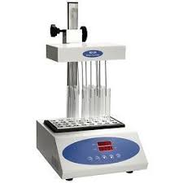
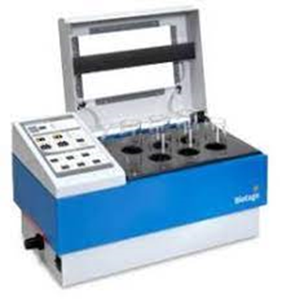
2. Concentration:
The solvent volume can be vaporized by a gentle stream of nitrogen gas across the surface or through the solution.
But when a large volume of solvent should be removed, a rotary vacuum evaporator is used.
It should be noted that evaporation should stop before the solution reaches dryness

Slide 9
3. Clean-up:
Many solid matrices, as soil, biological materials, and natural products, contain hundreds of interferences at higher concentrations than those of the analytes.
So, a cleanup step is vital to separate the trace amount of analyte from interferences.
Some cleanup techniques include gel permeation chromatography (GPC), acid-base partition cleanup and solid-phase extraction (SPE)

Slide 10
Application of gas chromatography
1. The application of gas chromatography to environmental analysis:
GC has significant role in the identification & quantification of pollutants of environment.
It is used in the analysis of different classes of organic contaminants in air, water, soils, sediments and biota. those organic pollutant groups such as:
polycyclic aromatic hydrocarbons (PAHs);
pesticides;
halogenated compounds such as polychlorinated biphenyl, organochlorine pesticides, brominated and organophosphate flame retardants, polybrominated biphenyls and polybrominated diphenyl ethers.

Slide 11
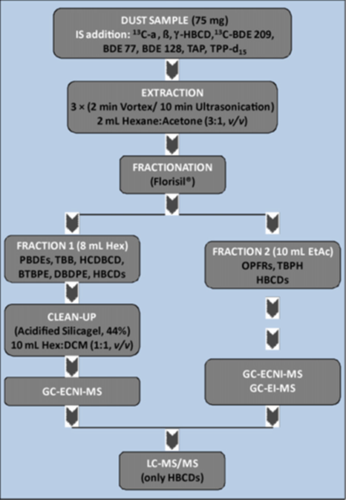
For Example,
In order to determine of brominated and organophosphate flame retardants in dust samples,
extraction and clean-up steps , then employ an appropriate analytical method such as GC-MS or LC-MS.

Slide 12
2. Application of gas chromatography in food analysis:
Gas chromatography is widely used in food industry for ensuring the safety of food products, preventing contaminated products from becoming available for consumption.
The technique is also essential to ensuring the quantity and quality of food products, ensuring that the flavor and taste, texture, and smell remain consistent.
While other techniques are implemented by the food industry, gas chromatography remains a highly favored method due to its ease of use and cost-effectiveness.

Slide 13
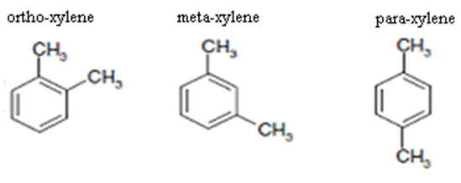
3. Application of GC in industry and petroleum products
To calculate the content and assuring the quality of a chemical product petroleum products such as jet fuel petrol, diesel and kerosene.
4. Application of GC in forensic science
Disciplines as diverse as solid drug dose (pre-consumption form)
Identification and quantification, fire investigation, paint chip analysis, and toxicology cases,
To identify and quantify various biological samples and crime-scene evidence
5. Application of GC in analysis of isomers
GC is used in analysis of isomers such as Xylene isomers o-xylene, m- xylene and p- xylene.

Slide 14
Liquid chromatography (LC)
Liquid chromatography (LC) is a separation technique in which the mobile phase is a liquid, where sample ions or molecules are dissolved.
The sample with the mobile liquid will pass through the column or the plane, which is packed with a stationary phase composed of irregularly or spherically shaped particles.
Due to the differences in ion-exchange, adsorption, partitioning, or size, different solutes will interact with the stationary phase to different degrees, and therefore the separation of the compounds can be achieved and the transit time of the solutes through the column can be determined.

Slide 15
There are several types of liquid chromatography:
1. Normal phase chromatography.
2. Reverse phase chromatography.
3. Ion exchange chromatography.
4. Size exclusion chromatography.
5. Affinity chromatography.

Slide 16
1. Normal phase chromatography (NPLC).
(NPLC) is a technique that uses columns packed with polar stationary phases combined with nonpolar or moderately-polar mobile phases to separate the components of mixtures.
The rate at which individual solutes migrate through NPLC columns is primarily a function of their polarity.
Less polar solutes move the fastest and therefore exit the column and are detected first, followed by solutes of increasing polarity which move more slowly.

Slide 17
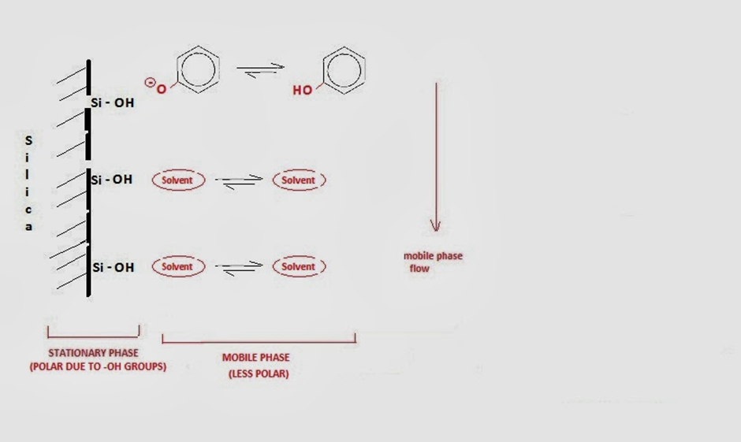
NPLC

Slide 18
The stationary phases in NPLC are usually silica or alumina and they are polar as a result of hydroxyl groups (-OH)
The surface hydroxyl groups interact with the functional groups on the solute molecules and depending on the strength of this interaction the solute is absorbed.
One solute relative to another (absorb the more polar compound relative to the less polar).
The mobile phase is nonpolar, using hexane or chloroform. Compounds with greater polarity elute later in the chromatogram and those with the least polarity elute earlier.

Slide 19
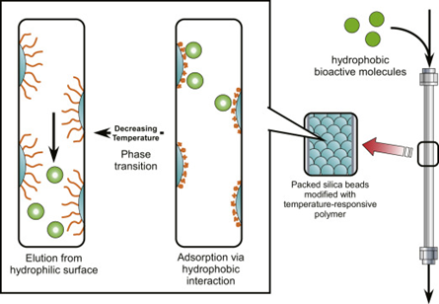
2. Reversed-phase liquid chromatography
RPLC is a liquid chromatography technique that involves the separation of molecules on the basis of hydrophobic interactions.
The mobile phase is a polar solvent and the stationary phase is non-polar.
The non-polar solutes (alkyl or aromatic ligands) are tended to get bound to the stationary phase.
water or mixtures of water with polar, water-miscible solvents are normally used.
In LC, HPLC) is used for the analysis of a wide range of application areas.

Slide 20
3. Ion exchange chromatography
This chromatography distributes the analyte molecule as per charge and their affinity towards the appositively charged matrix. Thus, only charged molecules can be separated
The analytes bound to the matrix are exchanged with a competitive reverse ion to elute.
The interaction between matrix and analyte is determined by net charge, ionic strength and pH of the buffer.
For example, when analytes loaded onto a negatively charged matrix, the neutral or negatively charged analyte will not bind to the matrix whereas positively charged analyte will bind.

Slide 21
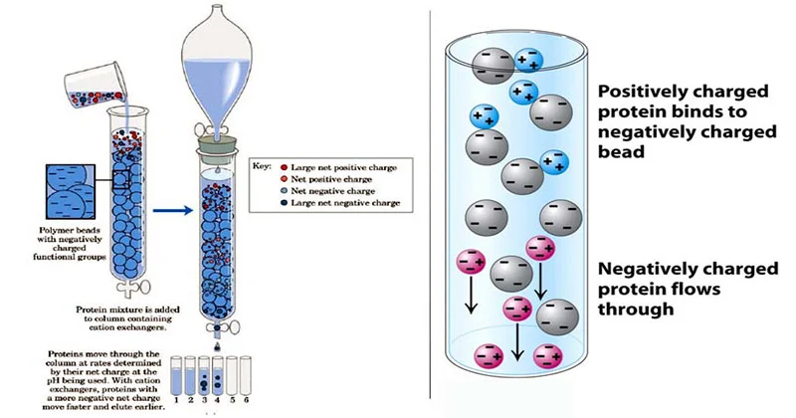
Ion exchange chromatography

Slide 22
There are two types of ion-exchange chromatography
a- Cation exchange chromatography- In matrix has a negatively charged functional group with an affinity towards positively charged molecules.
The positively charged analyte replaces the reversible bound cation and binds to the matrix.
In the presence of a strong cation such as Na+ is replaced with the elution of analyte.
b. Anion Exchange chromatography- In matrix has a positively charged functional group with an affinity towards negatively charged molecules.
The negatively charged analyte replaces the reversible bound anion and binds to the matrix.
In the presence of a strong anion such as Cl- is replaced with the elution of analyte.

Slide 24
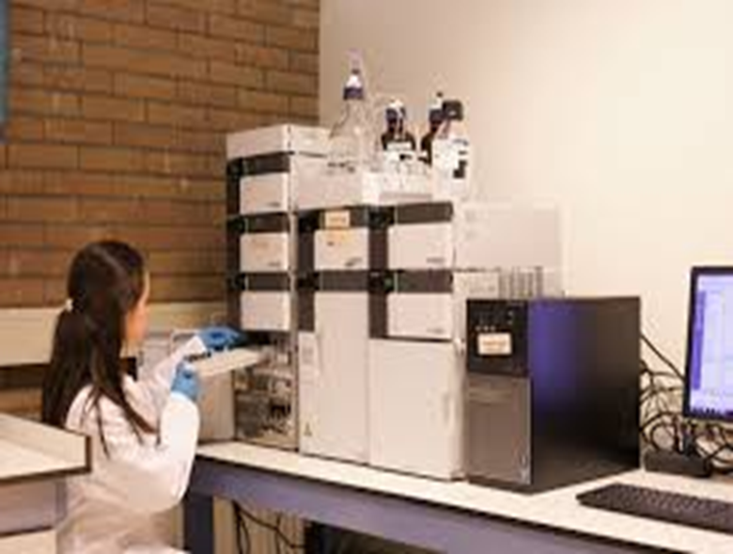
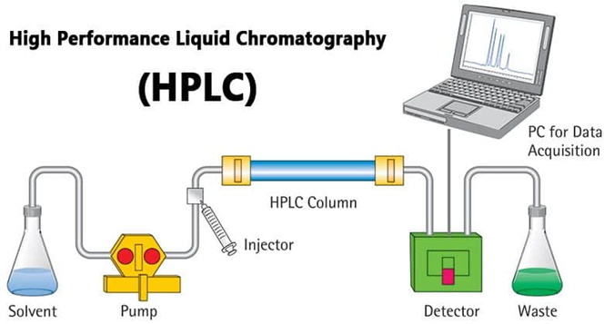
High Performance Liquid Chromatography
HPLC is developed from classical column liquid chromatography.
The basic HPLC instrumentation consists of pump(s), injector (manual or automatic injection), column(s), detector, and a data handling device

Slide 25
Solvent
The mobile phase, or solvent, in HPLC is usually a mixture of polar and non-polar liquid components whose respective concentrations are varied depending on the composition of the sample.
As the solvent is passed through a very narrow bore column, any contaminants could at worst plug the column, or at the very least add variability to the retention times during repeated different trials. Therefore, HPLC solvent must be kept free of dissolved gases, which could come out of solution mid-separation, and particulates.

